Slide 1
Smart Home Automation
Presented by Ch.Venkatesh (192210253)
K.Tejesh (192210210)

Slide 2
Introduction:
Smart home automation integrates connected devices that automate and streamline tasks, offering remote control and customization through apps and voice commands.
Designed to enhance convenience, efficiency, and security by automating routine tasks like adjusting lighting, temperature, and security systems.
Includes interconnected devices like smart lights, thermostats, security cameras, locks, and sensors, all managed from a central app or hub.
Offers energy savings, improved security, personalized comfort, and data-driven insights for a modern, optimized lifestyle.
As technology advances, smart home systems are becoming more affordable, accessible, and popular for households around the world.

Slide 3
Objective:
Energy Efficiency: Reduces utility bills by automatically adjusting lighting, HVAC, and appliances based on occupancy and time, minimizing energy waste.
Enhanced Security: Real-time monitoring and remote control of locks, cameras, and alarms provide a safer home environment with immediate alerts.
Convenience & Control: Offers easy, remote control over home devices through mobile apps or voice commands, allowing for effortless management.
Personalized Comfort: Automatically adjusts lighting, temperature, and other settings to suit preferences, enhancing comfort and creating a customized environment.
Increased Property Value: Smart features are attractive to buyers, potentially raising property value and offering a competitive edge in the market.

Slide 4
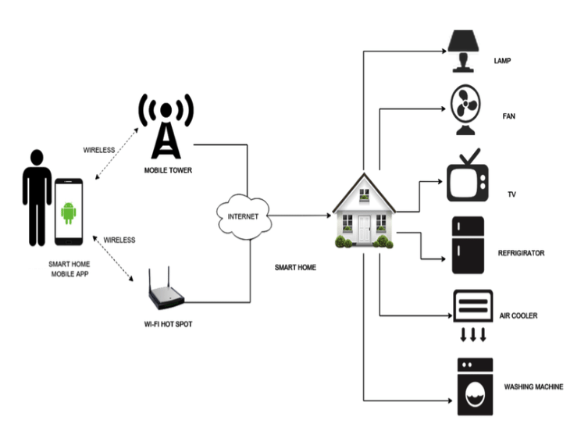
The diagram illustrates a smart home setup, where various devices like fans are interconnected through a central hub. This hub facilitates communication with a mobile tower via the internet, enabling remote control and monitoring of these devices using a dedicated smart home mobile app. The wireless connection ensures flexibility and convenience, allowing users to manage their home appliances from anywhere with an internet connection.

Slide 5
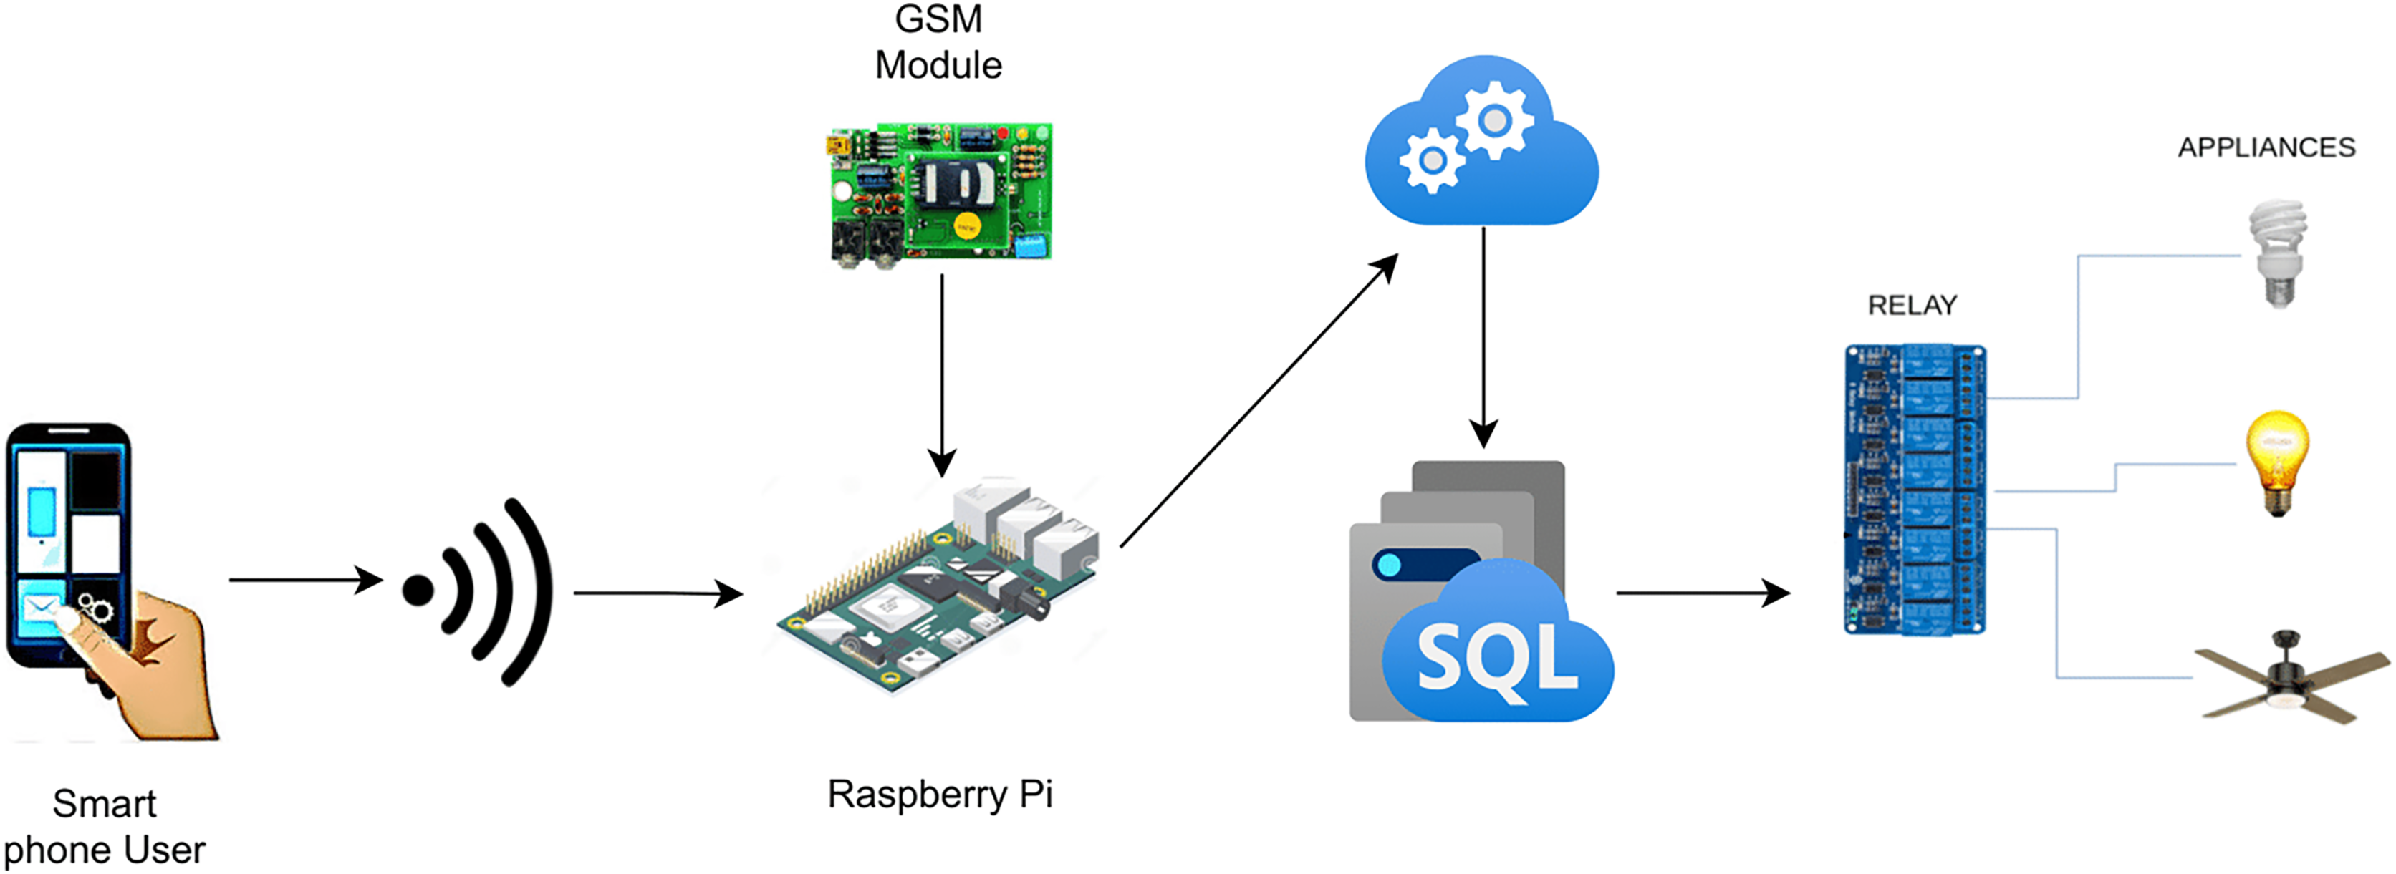
The diagram illustrates a smart home system centered around a Raspberry Pi. Users interact with the system through a smartphone app, sending commands that are processed by the Raspberry Pi. This mini-computer controls appliances like lights and fans using relays, and stores system data in an SQL database. The GSM module enables remote control even without Wi-Fi, while cloud integration offers additional features like remote access and voice control.

Slide 6
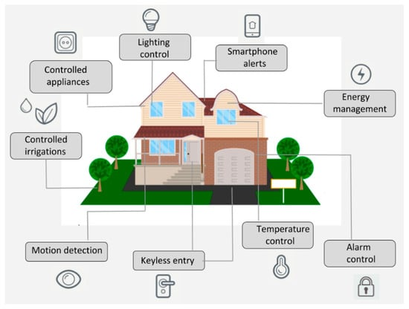
Smart Home Application

Slide 7
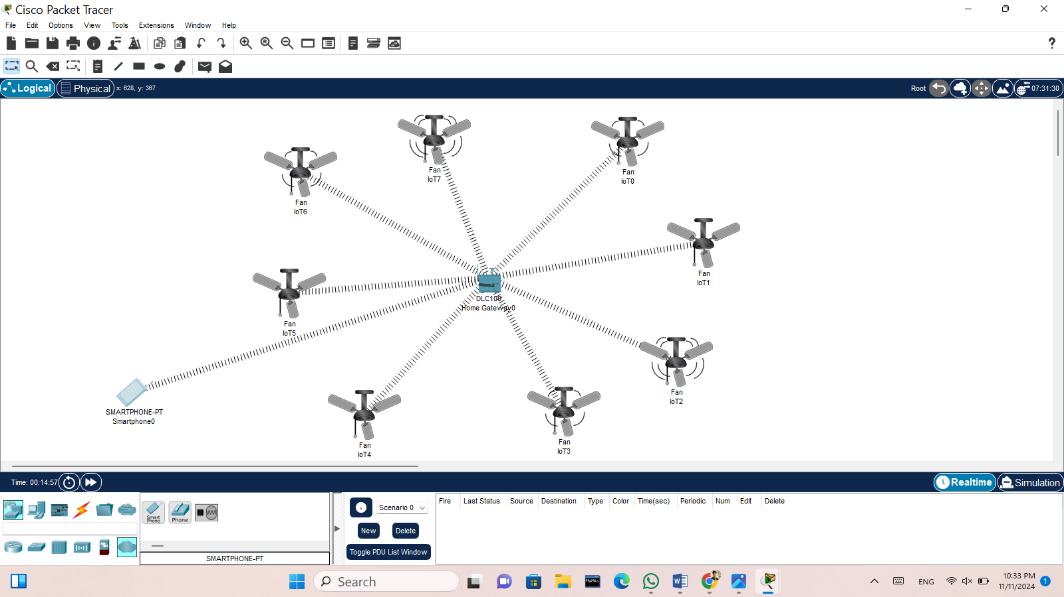
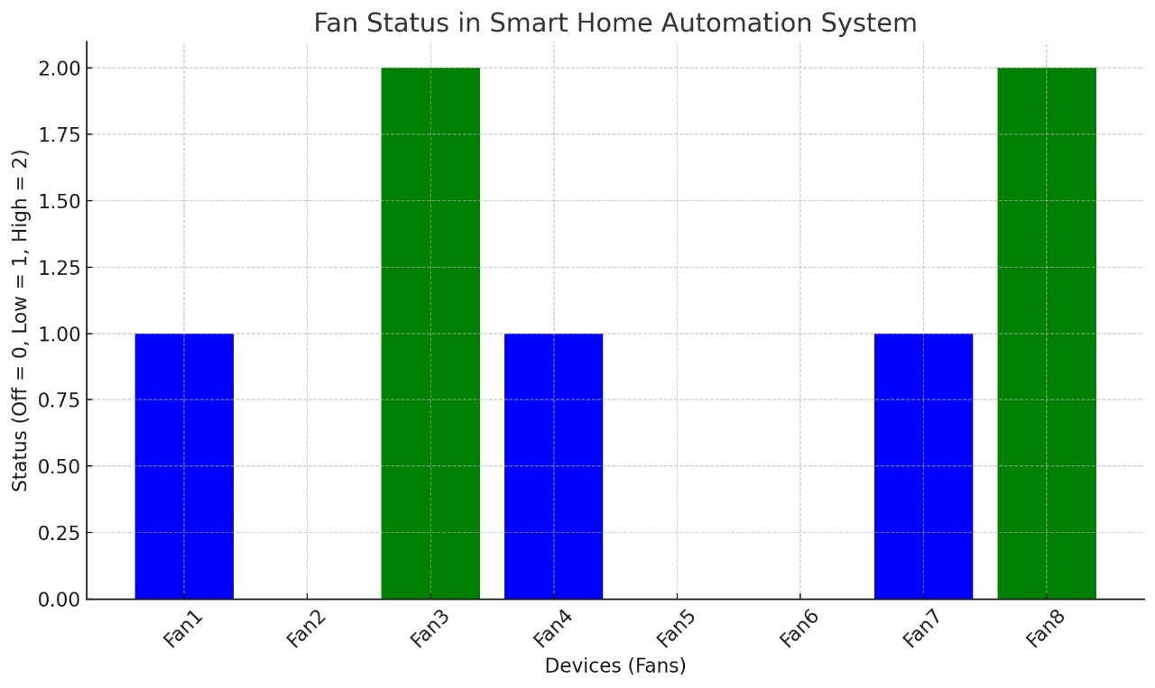
Results
The diagram illustrates a smart home system centered around a Raspberry Pi. Users interact with the system through a smartphone app, sending commands that are processed by the Raspberry Pi.
The data reveals that Fan 1, Fan 4, Fan 6, and Fan 7 are currently turned off, as indicated by the blue bars at the 0 level. Fan 3 and Fan 8 are operating at high speed, represented by the green bars at the 2 level.

Slide 8

Output
The output indicates that Fan 1, Fan 3, Fan 4, Fan 7, and Fan 8 are currently turned on at various speeds. Fan 2, Fan 5, and Fan 6 are all turned off. This information provides a clear snapshot of the current state of the fan system within the smart home, allowing for easy monitoring and control of fan operations.

Slide 9
Future Scope
AI-Driven Personalization: Advancements in artificial intelligence will enable homes to learn and predict user preferences
Interconnected Ecosystems: Future smart homes will operate as cohesive ecosystems where all devices communicate, creating a fully integrated environment
Sustainable Living: Future smart home systems will prioritize sustainability, including better energy management, waste reduction, and resource conservation
Advanced Health Monitoring: Smart homes will integrate health sensors to monitor vital signs, air quality, and other health-related data, enabling early detection of health issues.

Slide 10
Applications
Smart Elderly Care: Advanced monitoring and automation will assist elderly people in daily tasks, monitor their health, and provide emergency assistance, promoting independent living.
Enhanced Home Security: AI-enhanced security systems with facial recognition and predictive threat detection will offer higher security levels, with automated responses to potential intrusions.
Automated Home Management: From robotic cleaning devices to smart kitchens, homes will manage themselves more independently
Augmented Reality (AR) Home Interfaces: AR-based interfaces will allow users to interact with and control home devices in 3D space

Slide 11
Conclusion
Smart homes will become more interconnected, with seamless integration across devices, creating a unified and efficient living environment.
AI-driven automation will allow homes to adapt to personal habits and preferences, making daily life more convenient, comfortable, and efficient.
Future smart homes will prioritize energy efficiency and eco-friendly practices, contributing to a more sustainable and resource-conscious lifestyle.
With advancements in health monitoring, security, and automation, smart homes will enhance safety, wellness, and independence for all residents.
As technology becomes more affordable and accessible, smart home automation will likely become a standard feature in homes worldwide, reshaping modern living.

Slide 12
Thank
You!

